Slide 1
Deep Learning based Collaborative Filtering
——The Survey of recommender system

Slide 2
Backgrounds

Slide 3
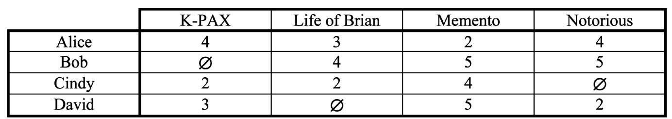
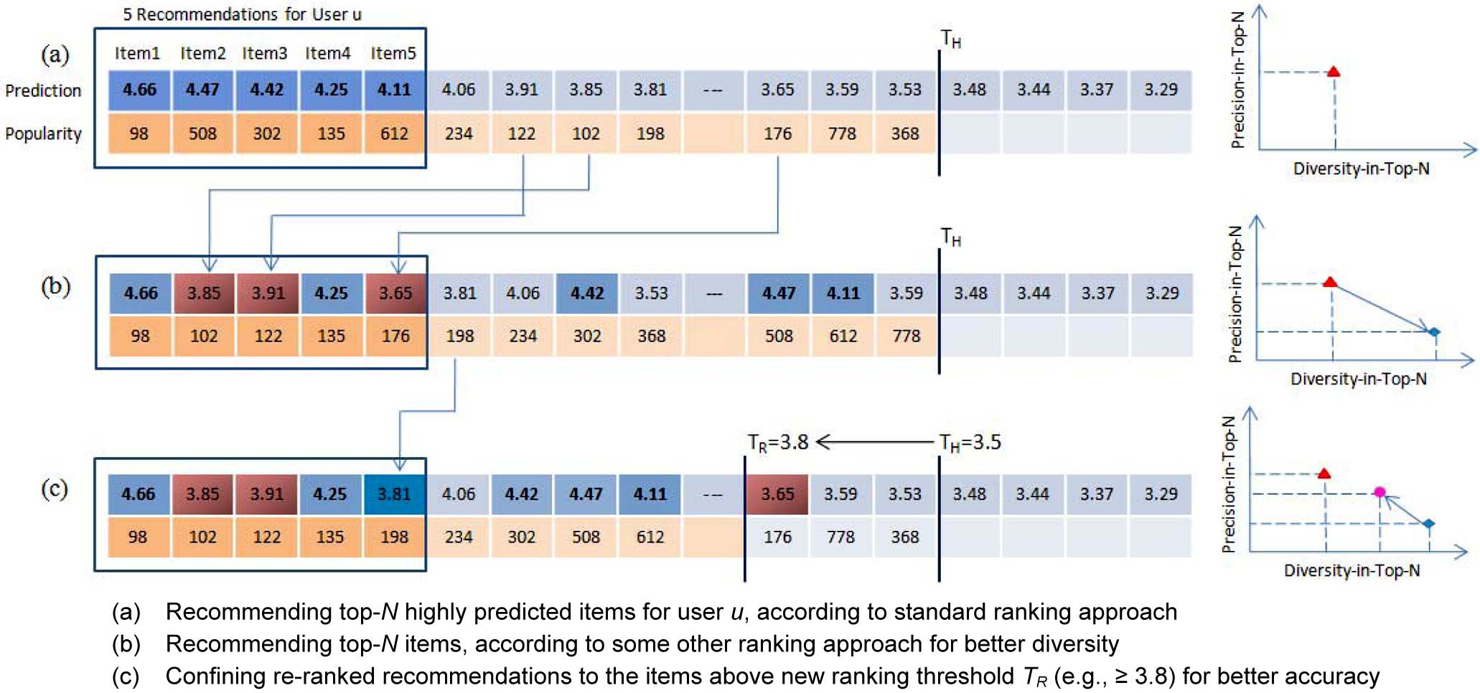
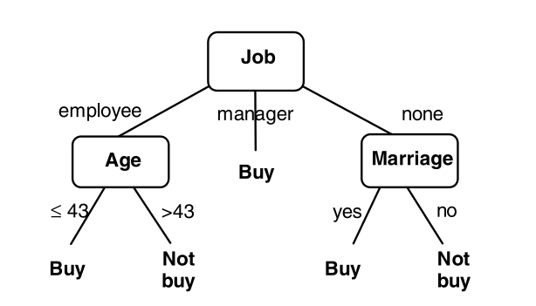
Recommender system
Recommender system is used for estimating users’ preference in items they have not seen. There mainly exists three
types of recommendation tasks based on the forms of outputs.
The form of outputs
rating prediction
ranking prediction
classification
a fragment of rating matrix for a movie recommender system
a decision tree for purchase assessment

Slide 4
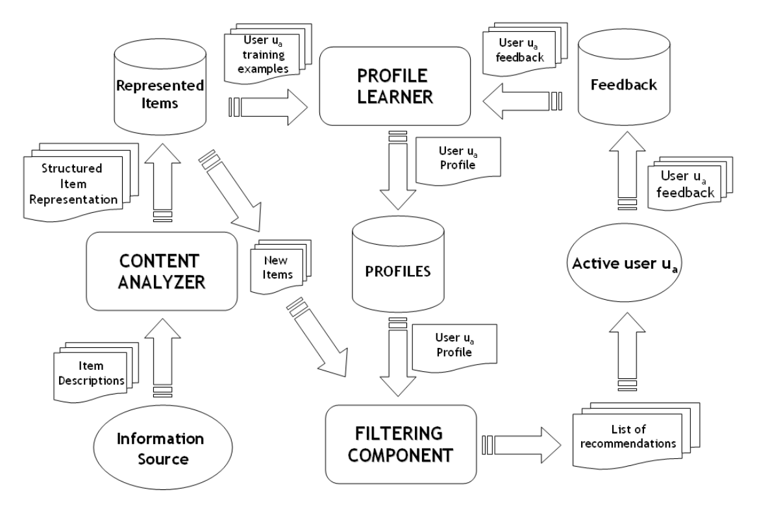
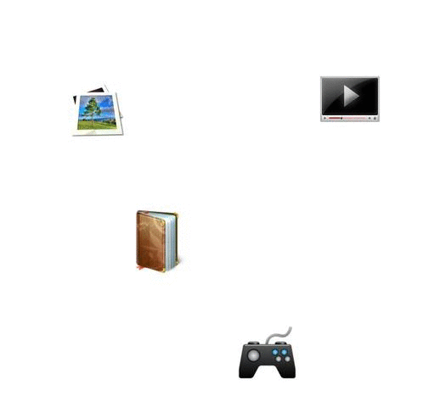
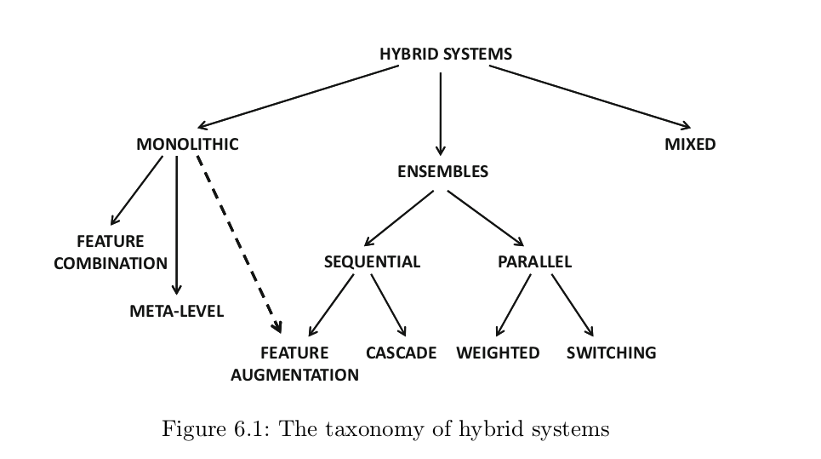
The category of recommendation models
Hybrid recommender system
based on the type of input data
Collaborative filtering
Content-based recommender system

Slide 5
proposed algorithm

Slide 6
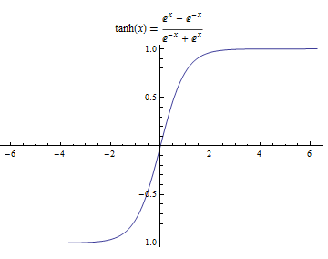
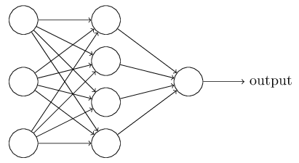
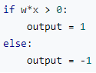
Deep Learning based Recommender System
Multilayer Perception based recommender system

Slide 7
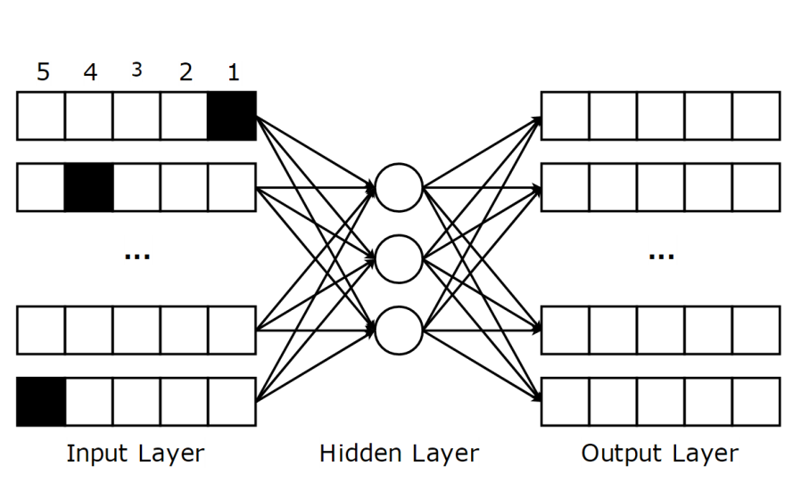
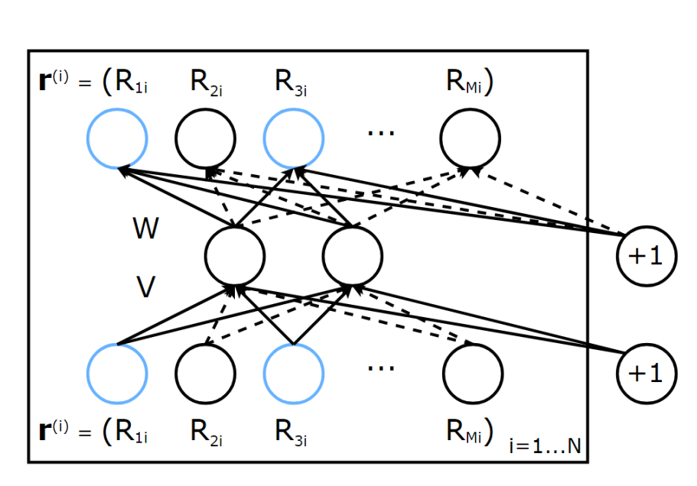
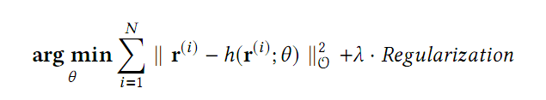
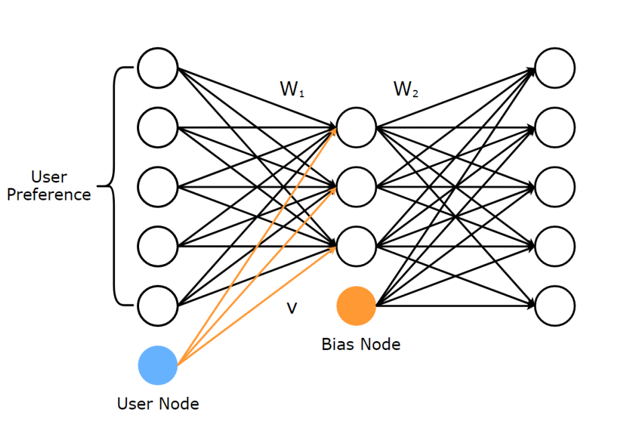
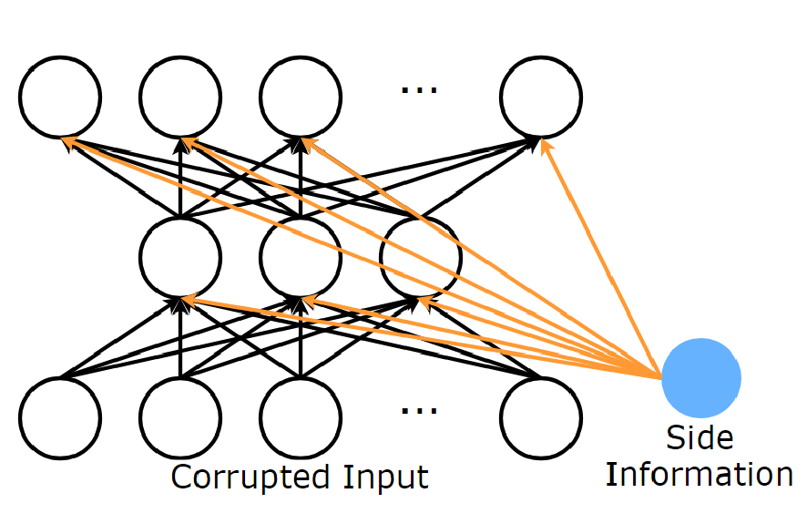
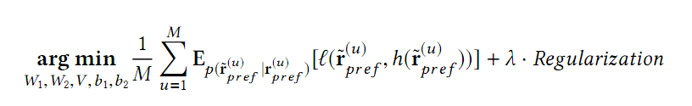
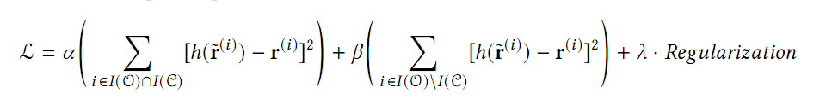
Deep Learning based Recommender System
I-AutoRec
AFN
CDFN
CFN
Auto-encoder based recommender system

Slide 8
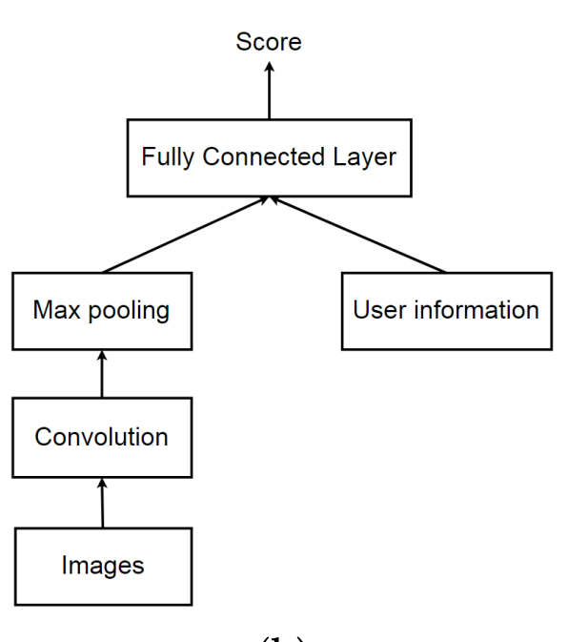
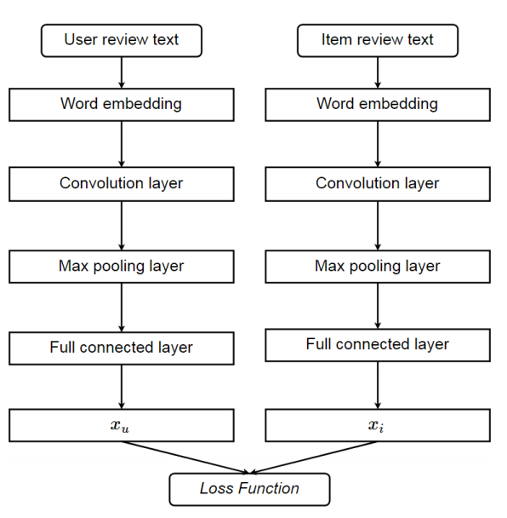
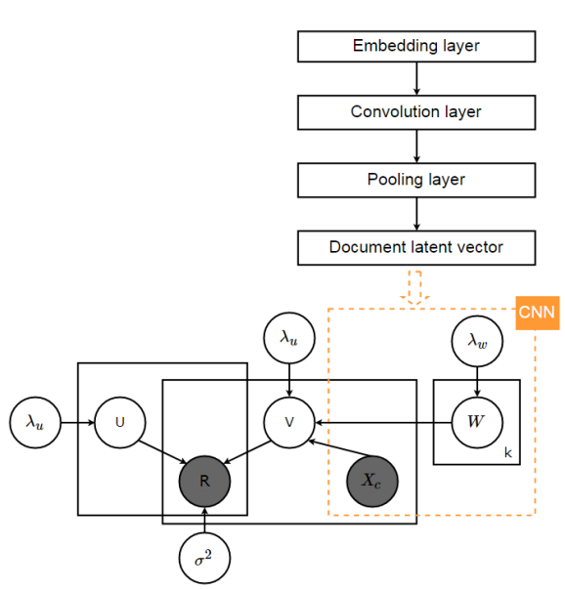
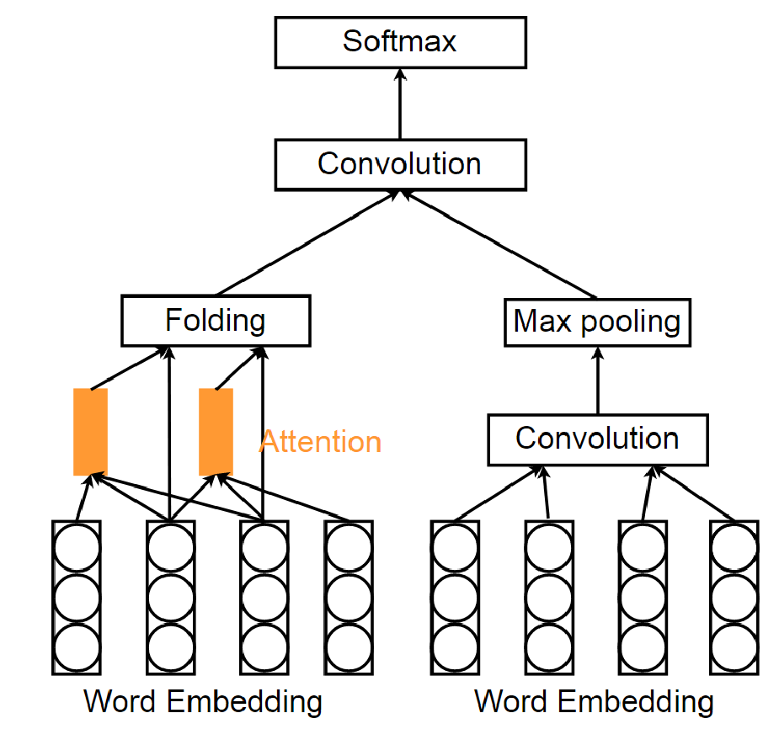
Deep Learning based Recommender System
Attention based CNN
Personalized CNN tag recommendation
DeepCoNN
ConvMF
Convolutional Neural Network based recommender system

Slide 9
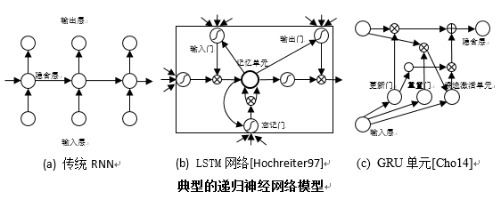
Deep Learning based Recommender System
Recurrent Neural Network based recommender system

Slide 10
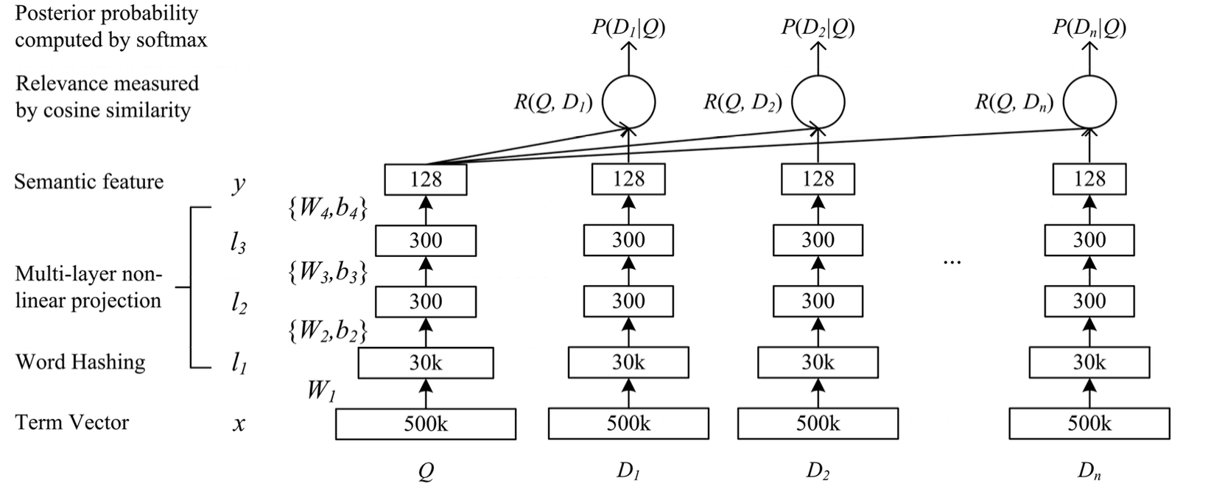
Deep Learning based Recommender System
Deep Semantic Similarity Model based recommender system

Slide 11
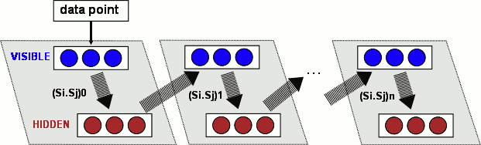
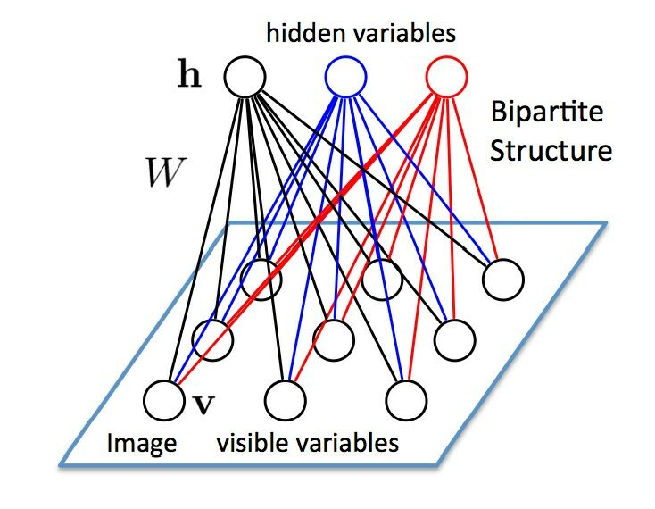

Deep Learning based Recommender System
Restricted Boltzmann Machine based recommender system
Emerging Method: NADE and GAN

Slide 12
Approach and experiment

Slide 13
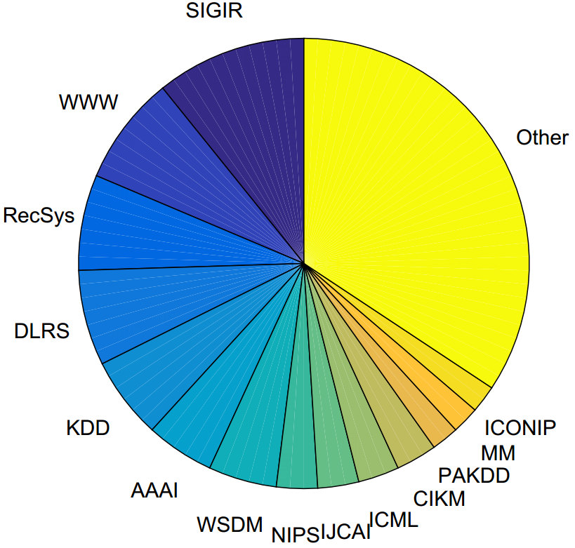
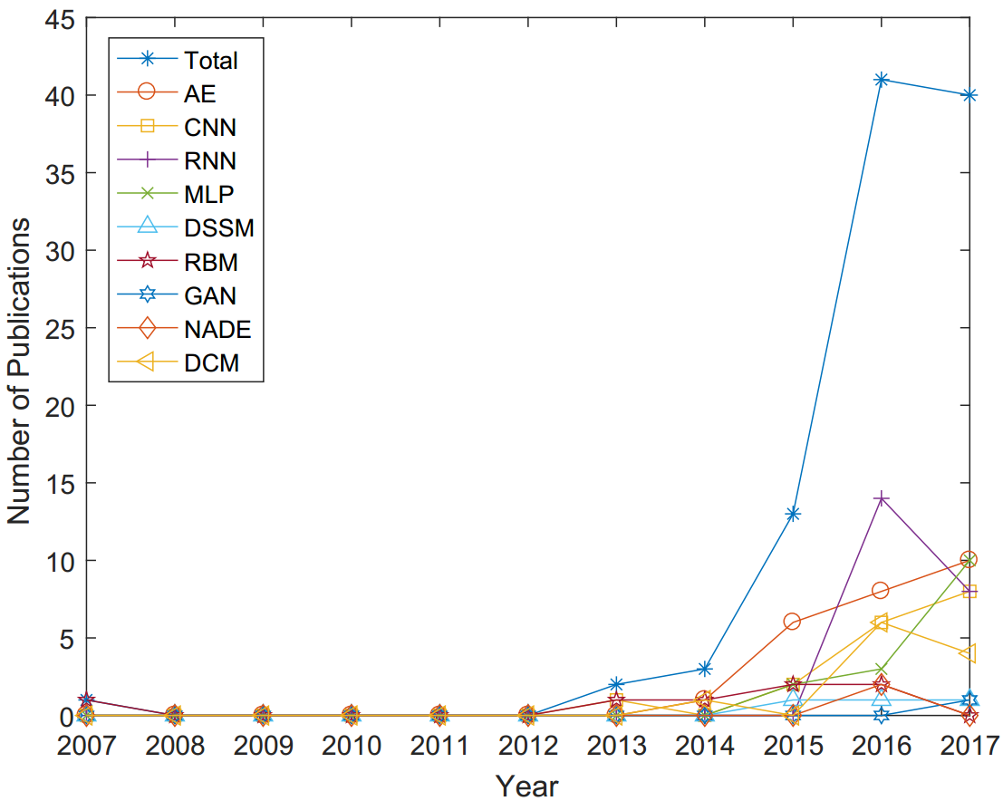
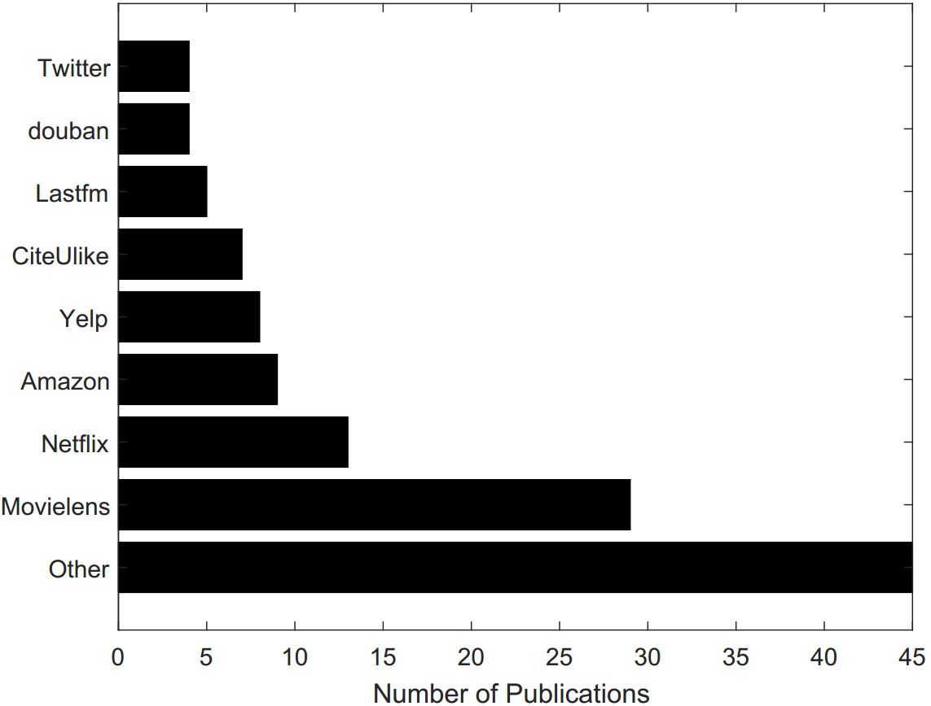
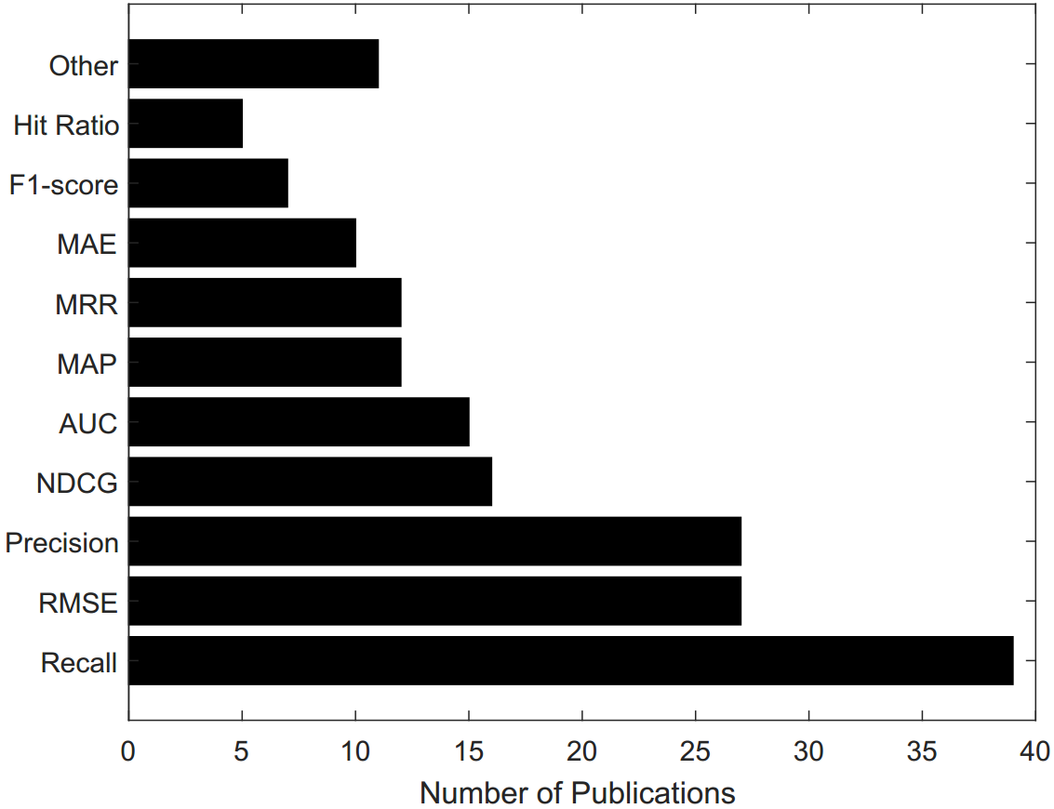
Database and Evaluation metrics
(a) Number of publications in each year
(b) Venue of publications
Most influential works with yearly
citation greater than 10
(c) Datasets in use
(d) Evaluation metrics in use

Slide 14
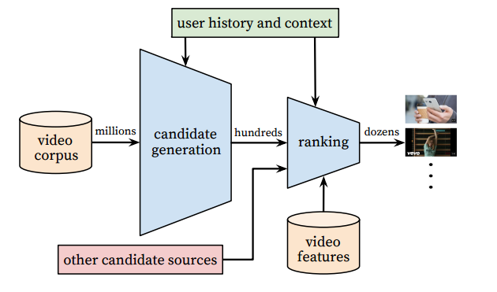
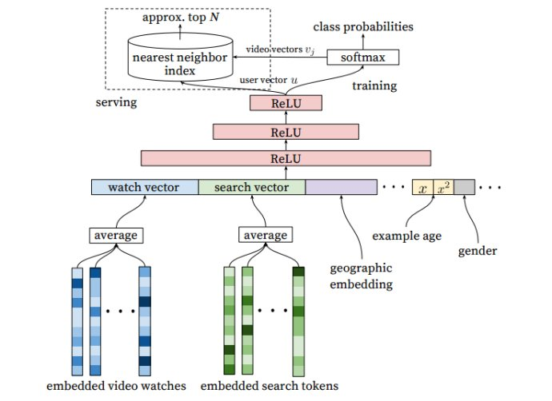
Recommendation System Design, Model Design
System Design
Model Design

Slide 15
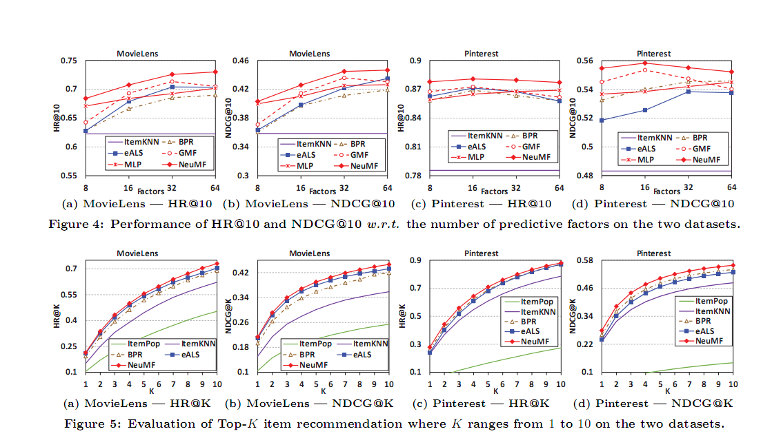
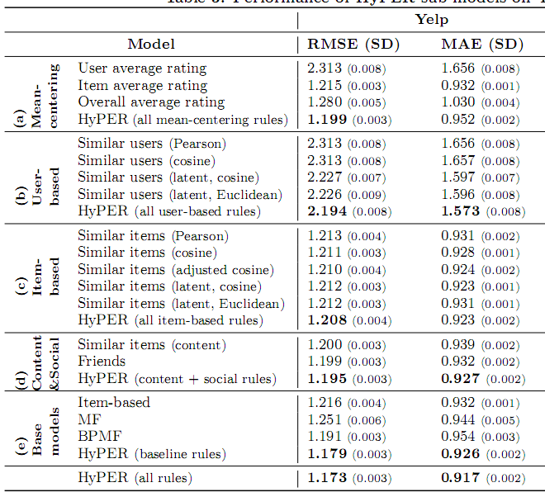
Experiment Validation

Slide 16
Thanks for listening!

